Slide 1

The CODATA-RDA Research Data Science Schools
SciDataCon, Gabarone, Nov 7, 2018
Hugh Shanahan
Royal Holloway, University of London
@hughshanahan

Slide 2
Mind the Gap
Recognized need for basic and advanced data skills -
Researchers need to be empowered to do more with their data
Without more widespread data handling, data management and
data science skills the benefits of the data revolution and open data
will not be fully realized.
Researchers need to bridge a gap in a relatively small set of Data Science skills

Slide 3
CODATA-RDA Schools
Aim to close gap in Data Science skills
for Early Career Researchers ’s working in any data-related domain.
Priority is for ECR’s from Low and Middle Income Countries
Use the term ‘Research Data Science’ to describe set of skills
10 Working day course - ‘wide and shallow’

Slide 4
Software Carpentry
- Command Line Interface
- Git
- R
- SQL (being phased out)
Visualisation
- ggplot2
Computational Infrastructures
- Cloud Computing
- Grid Computing
- Containers (Singularity)
Open Science
- Reflection/Discussion
Research Data Management
- Data Lifecycle
- Data Management Plan
- Licensing
Analysis
- Recommender Systems
- Neural networks/Classification
Information Security
(New for 2018!!)
- File permissions
- Buffer overflow
Author Carpentry
- DOI
- Orcid
- curl

Slide 5
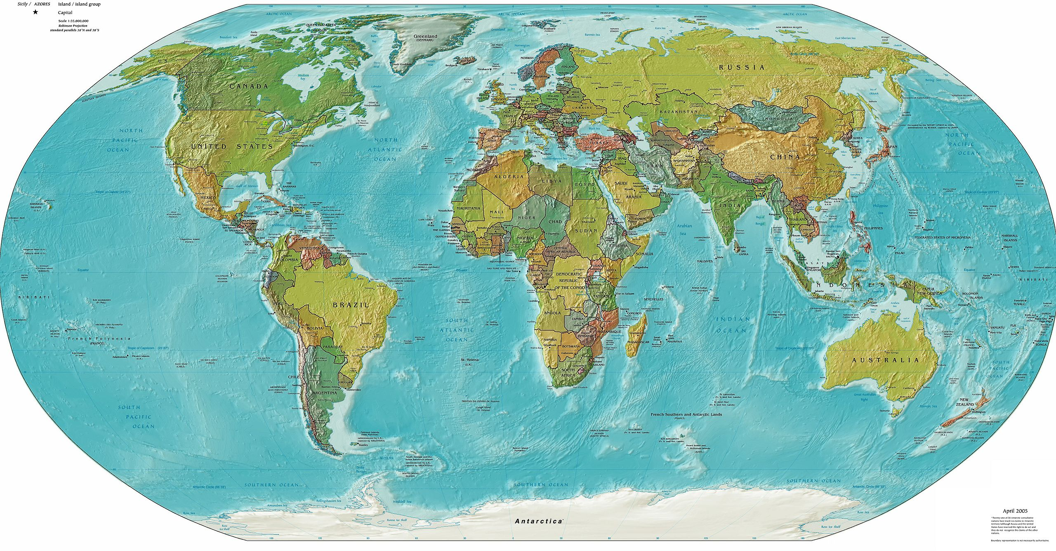
Trieste, Aug 2016
July 2017
Aug 2018
San José, Dec 2019
Aug 2019
Kigali, Oct 2018
Brisbane, Jun 2018
?? 2019
São Paulo Dec 2017
Dec 2018

Slide 6
The people
~250 students from 5 delivered schools
~20 student helpers
~40 Instructors

Slide 7
The future
2-3 African events planned for 2019
Continue to evolve curriculum
Central Office proposal
Continue to build the base of funding organisations
Spin-off events

Slide 8
Trieste school application web page
http://indico.ictp.it/event/8706/

Slide 9
The other Co-chairs
Louise Bezuidenhout, University of Oxford
Marcela Alfaro Córdoba, Universidad de Costa Rica
Sarah Jones, Digital Curation Centre
Rob Quick, Indiana University
ICTP Local Organiser
Executive Director of CODATA
Clement Onime
Simon Hodson

Slide 10
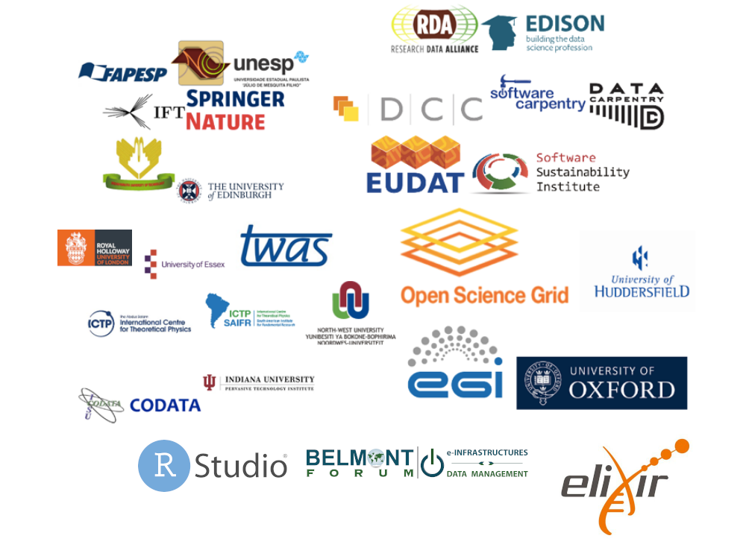
Our partners

